Slide 1



Hardware and Software Fundamentals of Intelligent Computing Systems

Slide 2
Lecture 24：Layout and Memory Planning

Slide 3
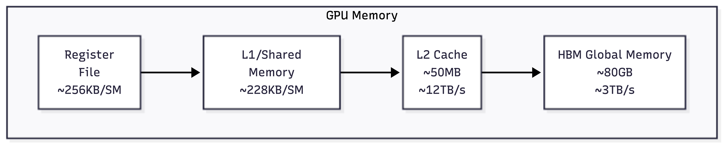
GPU Memory Hierarchy
Bandwidth increases 10-100x from left to right 10-100x
Capacity decreases 100-1000x from right to left 100-1000x
The key to layout optimization is maximizing high-speed memory utilization
Design programs for efficient memory usage, minimizing excessive data movement
FlashAttention core design philosophy

Slide 4
GPU Memory Transaction Mechanism
GPU accesses Global Memory not byte-by-byte, but in fixed-size "transactions":
Each memory transaction transfers 32 bytes or 128 bytes
Transactions must be aligned to their size boundaries
A warp（32 threads) are coalesced into as few transactions as possible
Maximum concurrent transactions are limited，constrained by memory controller queue depth
Number of transactions × latency = total wait time
Coalesced Access
When a warp 's 32 threads access addresses meeting the following conditions, they can be coalesced into minimal transactions
Addresses fall within the same or adjacent cache lines
Each thread accesses contiguous elements

Slide 5
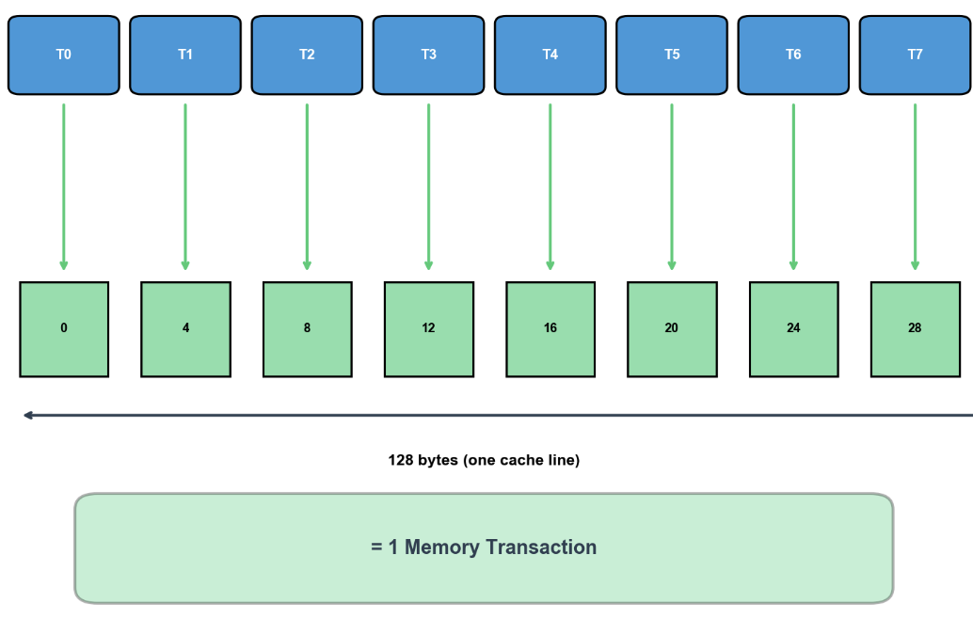
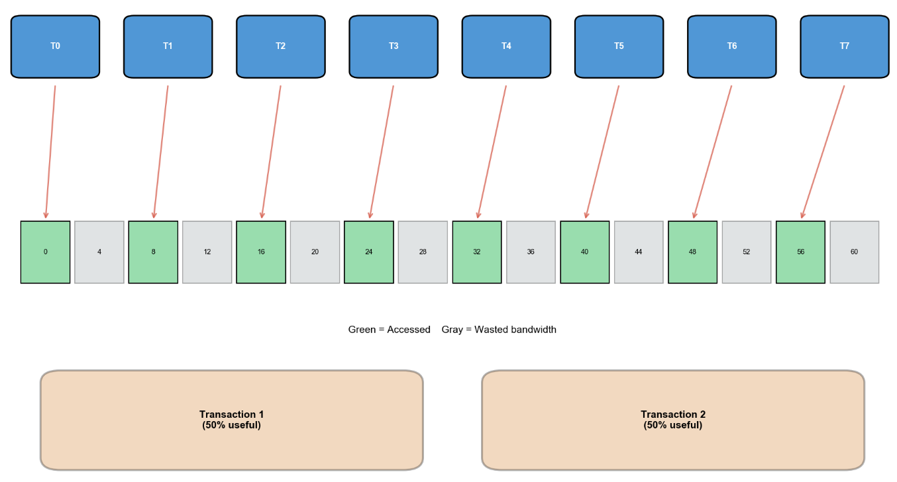
GPU Memory Transaction Mechanism
Contiguous access：1 transaction(s) suffice
Strided access：2 transactions
int idx = threadIdx.x; // T0→0, T1→1, T2→2, ...
float val = data[idx]; // Contiguous addresses
int idx = threadIdx.x 2; // T0→0, T1→2, T2→4, ...
float val = data[idx];

Slide 6
GPU Memory Transaction Mechanism
Random access: worst case 32 transactions
Efficiency Comparison
int idx = index_table[threadIdx.x]; // Random addresses
float val = data[idx];
Stride | Transactions | Bandwidth Utilization
1 | 1 | 100%
2 | 2 | 50%
4 | 4 | 25%
32 | 32 | 3.125%
Random | Up to 32 | ～3.125%

Slide 7
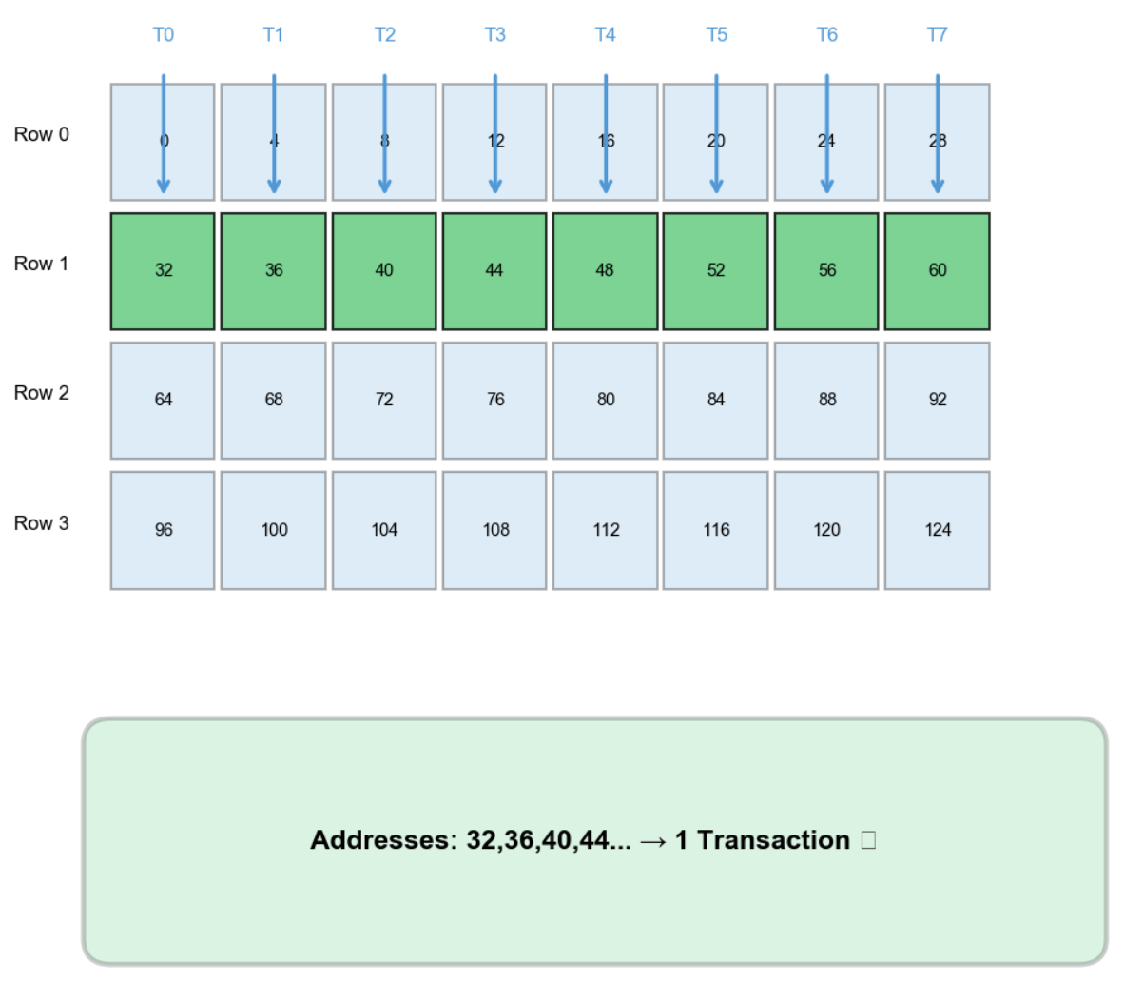
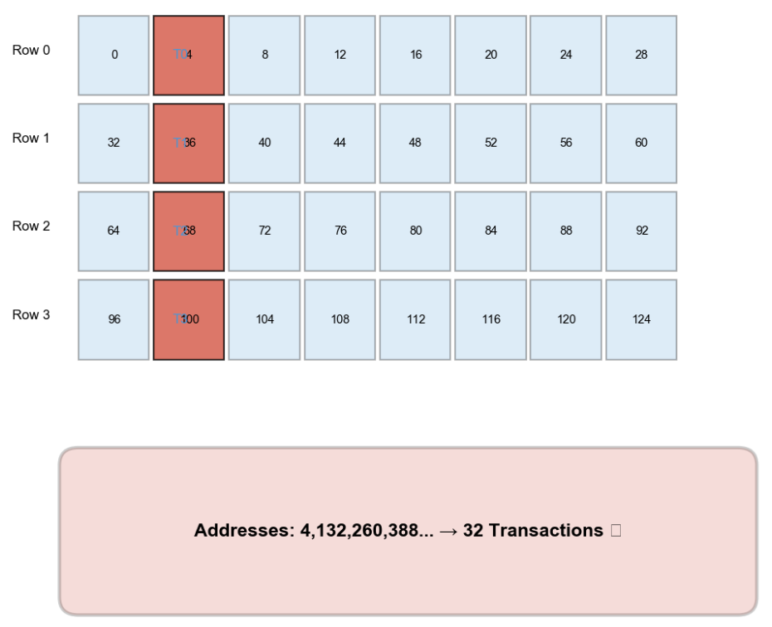
Matrix Access: Row-Major vs Column-Major
A warp reads one row
A warp reads one column
int col = threadIdx.x; // 0,1,2,...,31
float val = M[row 32 + col];
int row = threadIdx.x; // 0,1,2,...,31
float val = M[row 32 + col];

Slide 8
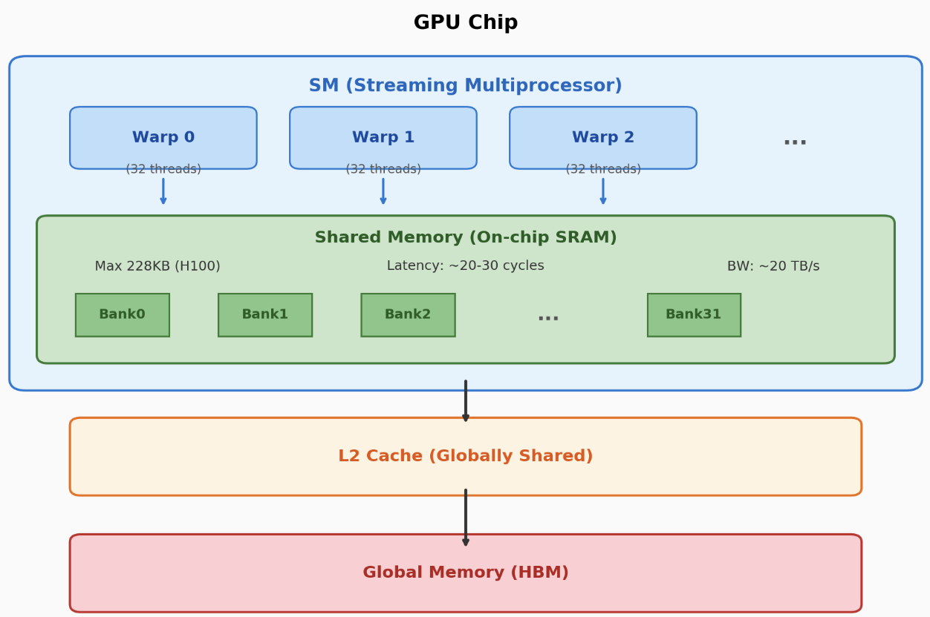
GPU Shared Memory
~100x faster than Global Memory ~100 x, but ~1000x smaller in capacity~1000
Programmers can explicitly control data placement
Shares space with L1 Cache Cache; ratio is manually configurable
Shared Memory is divided into 32 independent Bank
Can simultaneously serve 32 requests
Ideal case: 32 threads simultaneously access 32 different Bank
Efficient utilization of Shared Memory is the core of memory layout planning
When multiple threads within the same Warp map to the same Bank , serialized access is required

Slide 9
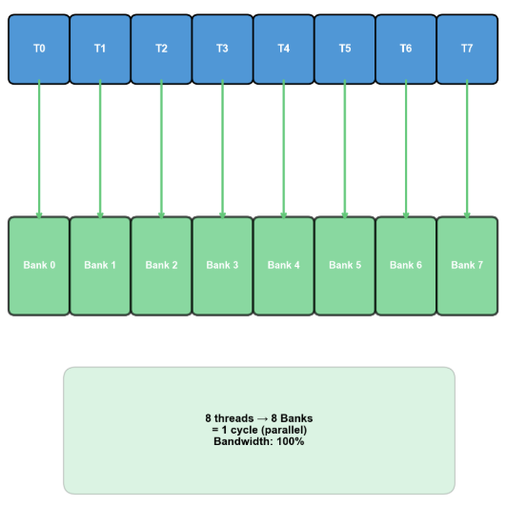
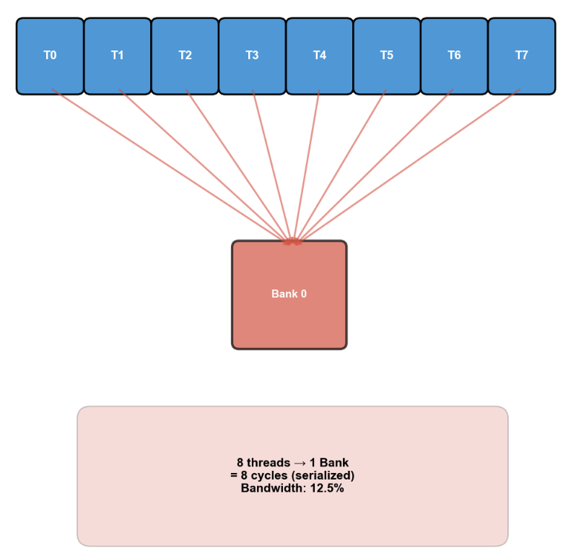
GPU Shared Memory
Ideal Case vs. Worst Case
Access patterns causing Bank Conflict
Access with specific stride values
Access with specific stride value（32）
int row = threadIdx.x; // 0 to 31
float val = smem[row][0]; // All threads access column 0
int idx = threadIdx.x 32;
float val = smem_1d[idx]; // idx = 0, 32, 64, 96, ... All mapped to Bank 0

Slide 10
Resolving Bank Conflict
Padding
Increase actual storage size per row, staggering column elements to different Bank
Swizzling
Dynamically alter address mapping via XOR operations, so the same column in different rows maps to different Bank
Original: addr = row × stride + col
Swizzle: addr = row × stride + (col XOR row)
__shared__ float smem[32][32]; Row 0: [B0 ][B1 ][B2 ]...[B31] ← 128 bytes
Row 1: [B0 ][B1 ][B2 ]...[B31] ← 128 bytes, starts at Bank 0
Row 2: [B0 ][B1 ][B2 ]...[B31] Column access: : smem[0][0], smem[1][0], smem[2][0], ...
All in Bank 0 → 32-way conflict
Accessing column 0:
row 0, col 0 → addr 0 → Bank 0
row 1, col 0 → addr 128 → Bank 0
row 2, col 0 → addr 256 → Bank 0
row 3, col 0 → addr 384 → Bank 0
32-way conflict
__shared__ float smem[32][33]; // Each row has 1 extra element(s) Row 0: [B0 ][B1 ][B2 ]...[B31][B0 ] ← 132 bytes (33 float)
Row 1: [B1 ][B2 ][B3 ]...[B0 ][B1 ] ← starts at Bank 1
Row 2: [B2 ][B3 ][B4 ]...[B1 ][B2 ] ← starts at Bank 2 Column access: : smem[0][0] → Bank 0
smem[1][0] → Bank 1 ← Different Bank
smem[2][0] → Bank 2 ← Different Bank
No conflict
Accessing column 0 (col XOR row):
row 0, col 0^0=0 → Bank 0
row 1, col 0^1=1 → Bank 1
row 2, col 0^2=2 → Bank 2
row 3, col 0^3=3 → Bank 3
No conflict

Slide 11
Triton Automatic Layout Optimization
The compiler automatically generates swizzled access code based on these parameters
vec: Number of contiguously accessed elements, affects vectorization
perPhase and maxPhase: Control swizzle period
Triton compiler automatically handles Shared Memory layout optimization
#shared = #triton_gpu.shared<{
vec = 4, // Vectorization width (accesses 4 elements at once)
perPhase = 2, // Rows per phase
maxPhase = 8, // Maximum phase count (for swizzle)
order = [1, 0], // Memory traversal order
hasLeadingOffset = false
}
@triton.jit
def kernel(...):
# Triton automatically selects optimal layout
a = tl.load(A_ptr + offs) # Global → Register
# Explicitly using shared memory
# Triton automatically applies swizzling
a_shared = tl.trans(a) # Auto-optimized during transpose

Slide 12
Tensor Layout
Mapping from logical tensor elements to physical storage locations
Memory arrangement order
Distribution of elements across hardware units
Common Layout Types
Row-major，Row-contiguous storage, ，C/C++ default
Column-major，Column-contiguous storage，Fortran, MATLAB
Blocked，Block storage, ，GPU parallelism
Strided，Strided storage，Slicing operations
2x4 matrix: : Row-major:
┌─┬─┬─┬─┐ [0,1,2,3,4,5,6,7]
│0│1│2│3│
├─┼─┼─┼─┤ Column-major
│4│5│6│7│ [0,4,1,5,2,6,3,7]
└─┴─┴─┴─┘

Slide 13
Triton Layout Encoding
Using MLIR Attribute to represent layouts
BlockedEncodingAttr: GPU Global memory access pattern
SharedEncodingAttr: Shared memory access pattern (swizzle)
NvidiaMmaEncodingAttr: Tensor Core operation layout
DotOperandEncodingAttr: Matrix multiplication operand layout
Unified Layout Representation
Represent layouts as mappings from hardware positions (warp, thread, register) to logical indices (m, n)
Use binary bits for strides, XOR operation composition
#blocked = #triton_gpu.blocked<{
sizePerThread = [4], // Elements per thread
threadsPerWarp = [32], // Threads per warp
warpsPerCTA = [4], // Threads per CTA warp count
order = [0] // Dimension traversal order
}>

Slide 14
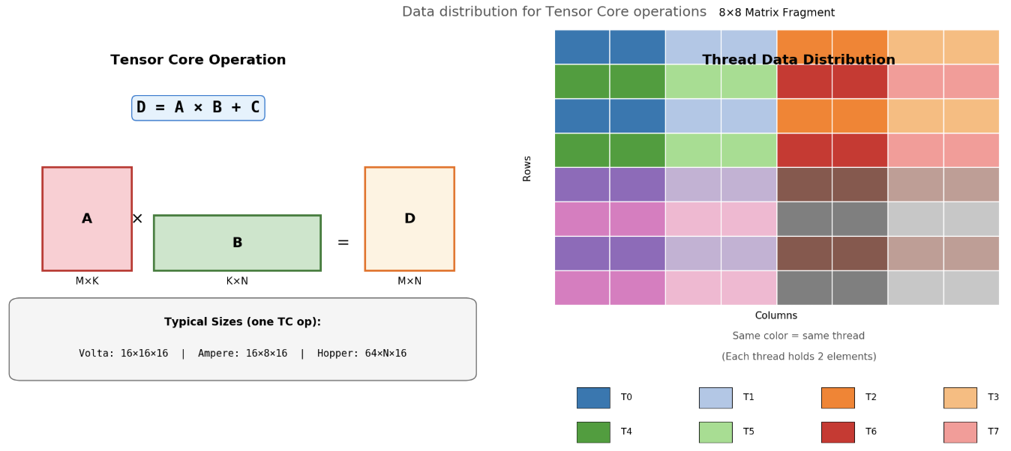
MMA (Matrix Multiply-Accumulate) Layout
Data arrangement designed for GPU Tensor Core
Tensor Core computes D = A × B + C
Fragment size is fixed (e.g., Volta architecture 16*16), conforming to TC hardware requirements
Each thread holds 8 elements
Thread 0: A[0,0:2], A[8,0:2], A[0,8:10], A[8,8:10]；Thread 1: A[0,2:4], A[8,2:4], A[0,10:12]；...

Slide 15
MMA (Matrix Multiply-Accumulate) layout
From Blocked to MMA Layout Conversion
ldmatrix instruction, loads from shared memory and rearranges to MMA layout
Read 8×8 matrix fragment from shared memory->Distribute to registers of threads within the warp ->Rearrange to MMA
Triton in TritonMMA Encoding Attribute
Triton Layout Conversion in Triton
#mma = #triton_gpu.nvidia_mma<{
versionMajor = 2, // MMA version (1=Volta, 2=Ampere, 3=Hopper)
versionMinor = 0,
warpsPerCTA = [2, 2], // Warp grid layout
instrShape = [16, 8, 16] // M × N × K instruction shape
}>
// From blocked layout to mma layout
%0 = triton_gpu.convert_layout %arg :
tensor<128x64xf16, #blocked> -> tensor<128x64xf16, #mma>

Slide 16
Memory Allocation Strategies
Static Allocation
Compile-time allocation，0 runtime overhead, predictable fragmentation, low flexibility
All tensor sizes known at compile time
Dynamic Allocation
Runtime allocation, with malloc overhead, high flexibility
ML Compiler Strategy
Compile-time analysis -> determine tensor lifetimes -> compute optimal allocation plan -> generate allocation code
Use memory pools to support dynamic shapes

Slide 17
Memory Reuse
Tensors with non-overlapping lifetimes can share memory
ABC can be reused among each other
D and ABC cannot be reused
Common Algorithms
Graph Coloring: Build interference graph, minimize number of colors
Greedy Algorithm: Sort tensors by size, maximize reuse
ILP Method: Integer Linear Programming for optimal solution
Minimize: : max(offset[i] + size[i]) for all i
Constraints: : 1. offset[i] >= 0 (Non-negative offset)
2. offset[i] + size[i] <= offset[j] (if i, j non-overlapping and i precedes) or offset[j] + size[j] <= offset[i] (if j precedes)
3. Tensors with overlapping lifetimes must have distinct address spaces
Tensor A: ████████████
Tensor B: ████████████
Tensor C: ██████████
Tensor D: ████████████████████

Slide 18
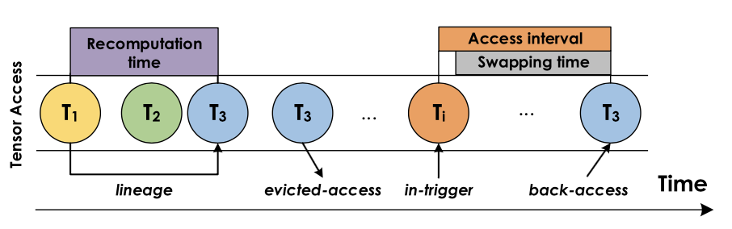
Tensor Rematerialization
GPU memory insufficient to store all intermediate tensors
Selectively discard and recompute
Input->A->B->C->Output
Do not store A, retain B and C for backward pass
Recompute during backward pass: A
Optimization Objective: Minimize (computation time + peak memory)
Runtime dynamic decision-making
Optimization problem solving
Image Source: Capuchin: Tensor-based GPU Memory Management for Deep Learning
Notes:
单击此处添加文本

Slide 19
Layout and Memory Planning Optimization Strategies
Layout Conversion
Defer conversions as late as possible
Detect and remove redundant conversions
Merge adjacent conversions
Prefer layouts favorable to dominant operations
Consider the entire computation graph, not just individual operators
Reduce Conversions
Unify to the same layout
Perform conversions at compute-intensive points
Combined with Dead Code Elimination
Reduce memory allocation: Remove dead variables -> no allocation needed
Shorten lifetimes: Remove useless operations -> free memory earlier
Enable more reuse: Shorter lifetimes -> more reuse opportunities

Slide 20

The Solution: FlagOS, a Unified AI Software Stack

Slide 21








https://space.bilibili.com/3546791834290849
https://github.com/flagos-ai
https://www.zhihu.com/people/95-22-20-18/posts
https://flagos.io/Home

Slide 22

Thanks for your time！

